Slide 1

Complexity loops, structural traps & regional development
Pierre-Alex Balland & Ron Boschma

Slide 2
AN EVOLUTIONARY FRAMEWORK FOR DEVELOPMENT TRAPS

Slide 3
Complexity Loops and Structural Traps
Median
Average Complexity
Median
Average Relatedness Density
Notes:
THIS IS A GENERALIZATION OF RIGBY; PINHEIRO; BALLAND 2019
I also like ’complexity traps’; it could diffuse well in the economic complexity literature?
I removed traps; now we only have 1 quadrant that is a trap

Slide 4
Complexity Loops and Structural Traps
Median
Average Complexity
Median
STRUCTURAL TRAP
This is stagnation zone and the worst form of trap. Regions face structural challenges both in terms of their current economic structure and capacity to adapt in the future
Average Relatedness Density
Notes:
THIS IS A GENERALIZATION OF RIGBY; PINHEIRO; BALLAND 2019
I also like ’complexity traps’; it could diffuse well in the economic complexity literature?
I removed traps; now we only have 1 quadrant that is a trap

Slide 5
Complexity Loops and Structural Traps
Median
COMPLEXITY LOOP
Regions have both complex economic structures and a strong ability to adapt and diversify. They are leading examples for continuous transformation and long-run growth
Average Complexity
Median
STRUCTURAL TRAP
This is stagnation zone and the worst form of trap. Regions face structural challenges both in terms of their current economic structure and capacity to adapt in the future
Average Relatedness Density
Notes:
THIS IS A GENERALIZATION OF RIGBY; PINHEIRO; BALLAND 2019
I also like ’complexity traps’; it could diffuse well in the economic complexity literature?
I removed traps; now we only have 1 quadrant that is a trap

Slide 6
Complexity Loops and Structural Traps
LOW RELATEDNESS TRAP
Median
COMPLEXITY LOOP
Regions have a complex knowledge base but a lower relatedness density, making them prone to "Success Traps" – where past success hinders adaptability to new paradigms
Regions have both complex economic structures and a strong ability to adapt and diversify. They are leading examples for continuous transformation and long-run growth
Average Complexity
Median
STRUCTURAL TRAP
This is stagnation zone and the worst form of trap. Regions face structural challenges both in terms of their current economic structure and capacity to adapt in the future
Average Relatedness Density
Notes:
THIS IS A GENERALIZATION OF RIGBY; PINHEIRO; BALLAND 2019
I also like ’complexity traps’; it could diffuse well in the economic complexity literature?
I removed traps; now we only have 1 quadrant that is a trap

Slide 7
Complexity Loops and Structural Traps
LOW RELATEDNESS TRAP
Median
COMPLEXITY LOOP
Regions have a complex knowledge base but a lower relatedness density, making them prone to "Success Traps" – where past success hinders adaptability to new paradigms
Regions have both complex economic structures and a strong ability to adapt and diversify. They are leading examples for continuous transformation and long-run growth
Average Complexity
Median
STRUCTURAL TRAP
LOW COMPLEXITY TRAP
This is stagnation zone and the worst form of trap. Regions face structural challenges both in terms of their current economic structure and capacity to adapt in the future
These regions can adapt and diversify into new activities due to their high relatedness density, but they are only able to do so in technologies of relatively low value
Average Relatedness Density
Notes:
THIS IS A GENERALIZATION OF RIGBY; PINHEIRO; BALLAND 2019
I also like ’complexity traps’; it could diffuse well in the economic complexity literature?
I removed traps; now we only have 1 quadrant that is a trap

Slide 8
MEASURING STRUCTURAL TRAPS WITH INDUSTRY DATA (SBS)

Slide 9
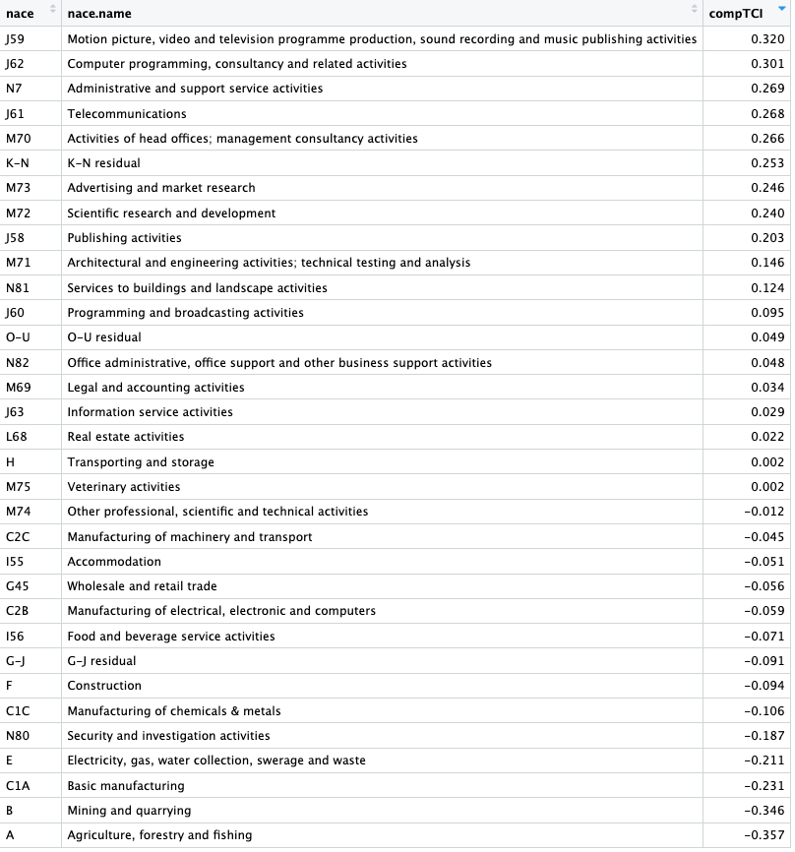
Industry Complexity Rankings (2011)
DATA:
- Structural Business Statistics (SBS) employment data by NUTS2 regions and NACE. Source of data: Eurostat.
- Annual Regional Database of the European Commission (ARDECO) employment data by NUTS2 regions and NACE. Source: Joint Research Centre & Directorate General for Regional and Urban Policy.
METHODOLIGICAL NOTE:
- SBS provides more disaggregated NACE codes (level 1, 2 and 3) but some sectors are entirely missing (A, K…)
- ARDECO is very comprehensive but much more aggregated
- We combine both datasets, and when relevant we subtract SBS employment count from ARDECO employment count (K-N residual for instance)
- By historical legacy, the NACE classification provides a more detailed classification for low-complex sectors such as manufacturing, so we re-aggregated to provide a more consistent employment count across categories.
- Complexity scores are computed following the eigenvector reformulation. See Hidalgo & Hausman (2009) and for a more recent discussion of economic complexity indicators Balland et al. (2022).

Slide 10
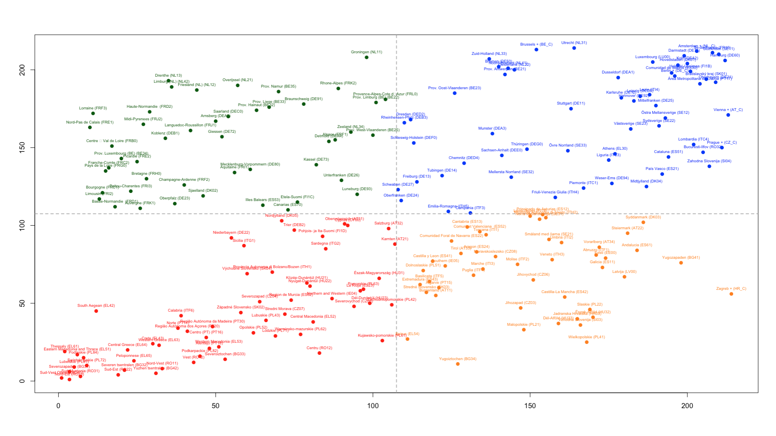
Complexity Loops & Structural Traps – Industries (rank)
Average Complexity
Average Relatedness Density
Notes:
THIS IS A GENERALIZATION OF RIGBY; PINHEIRO; BALLAND 2019

Slide 11
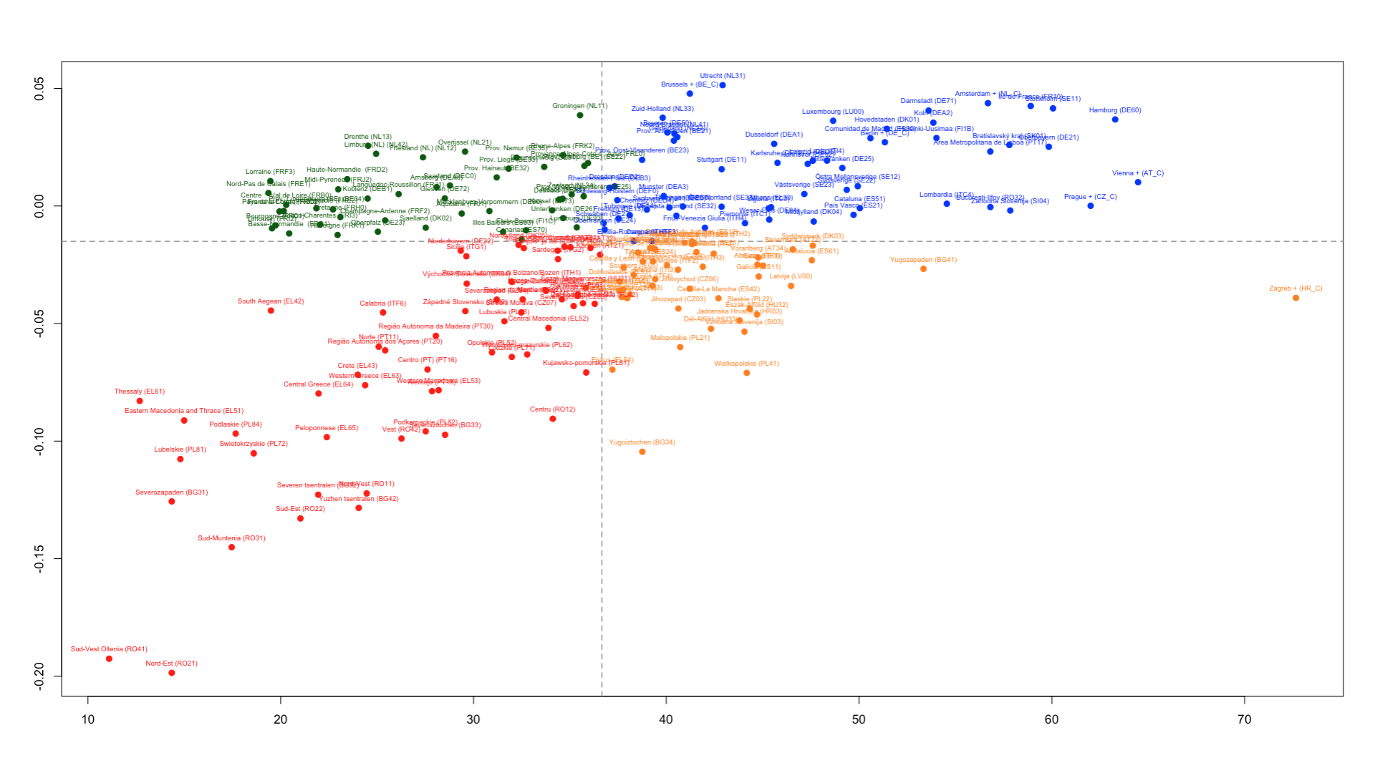
Complexity Loops & Structural Traps – Industries (values)
Average Complexity
Average Relatedness Density
Notes:
THIS IS A GENERALIZATION OF RIGBY; PINHEIRO; BALLAND 2019

Slide 12
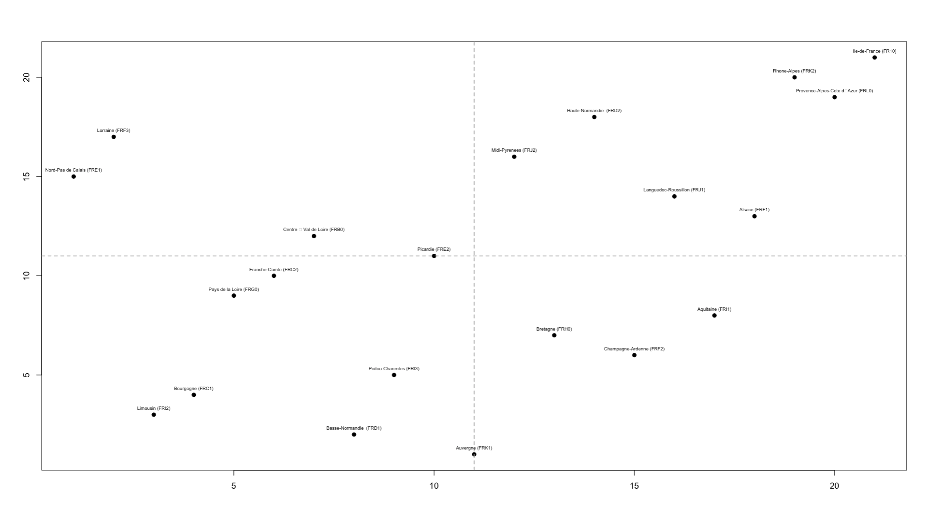
Complexity Loops & Structural Traps for France – Industries (rank)
Average Complexity
Average Relatedness Density
Notes:
THIS IS A GENERALIZATION OF RIGBY; PINHEIRO; BALLAND 2019

Slide 13
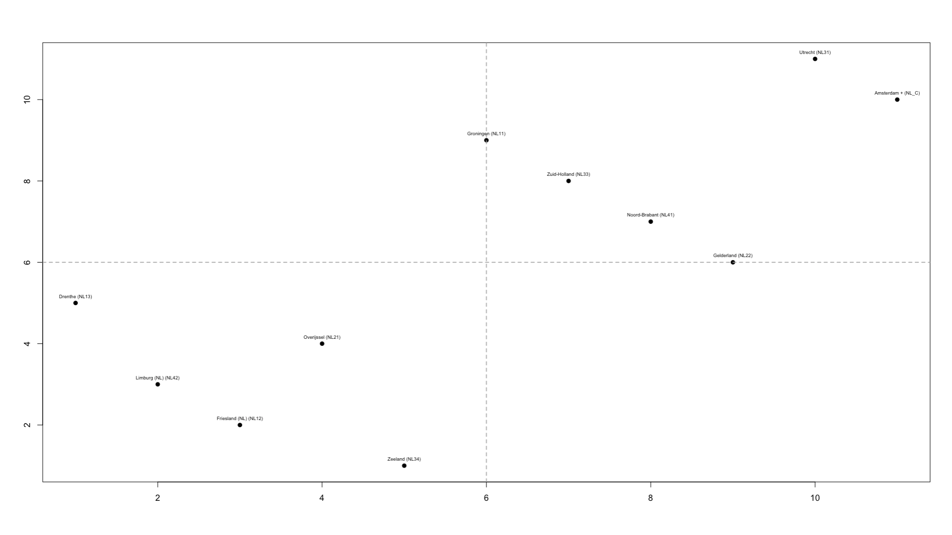
Complexity Loops & Structural Traps for the NL – Industries (rank)
Average Complexity
Average Relatedness Density
Notes:
THIS IS A GENERALIZATION OF RIGBY; PINHEIRO; BALLAND 2019

Slide 14
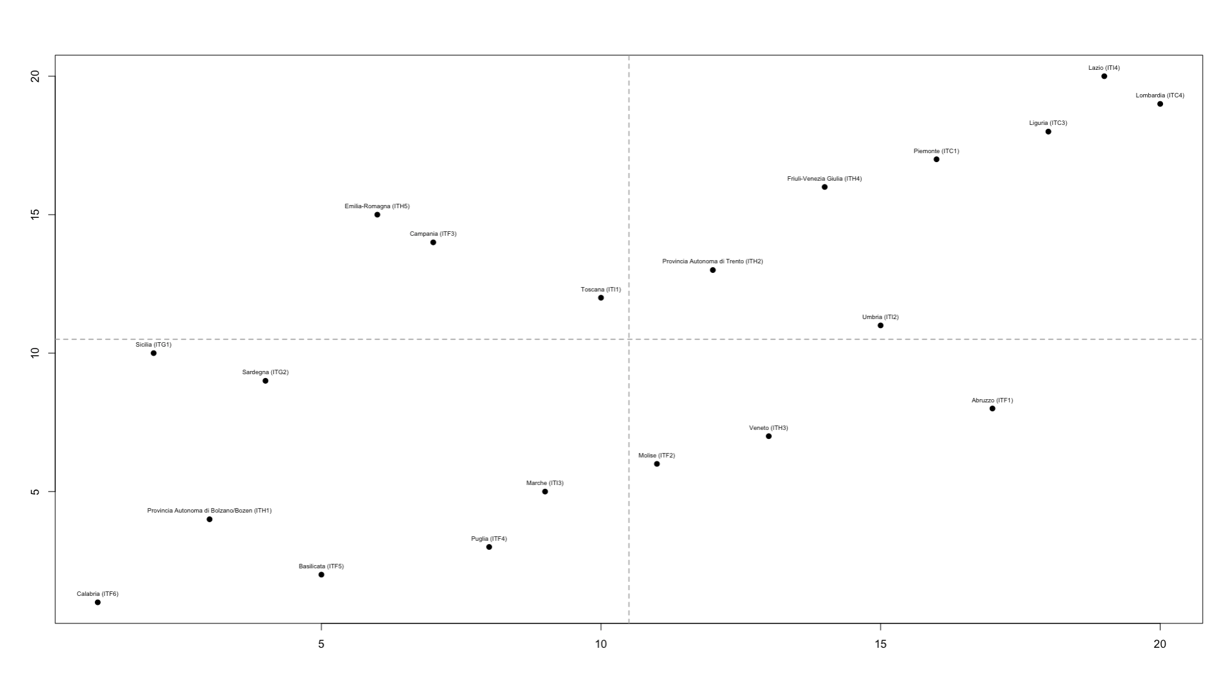
Complexity Loops & Structural Traps for Italy – Industries (rank)
Average Complexity
Average Relatedness Density
Notes:
THIS IS A GENERALIZATION OF RIGBY; PINHEIRO; BALLAND 2019

Slide 15
CAN (INDUSTRY) STRUCTURAL TRAPS EXPLAIN REGIONAL DEVELOPMENT?

Slide 16
A Simple Evaluation Framework
Median
Employment Growth & Wage Growth
Employment Growth & Wage Growth
Regions that manage to growth their employment base (>=median) while increasing wages (>=median) are the gold standard of regional development
Regions that manage to growth their employment base (>=median) while increasing wages (>=median) are the gold standard of regional development
Employment Growth
Median
Employment Decline & Wage Decline
Employment Decline & Wage Growth
Regions that saw a decline in their employment base (<median) while decreasing wages (<median) are in the worst economic condition
Regions that saw a decline in their employment base (<median) while increasing wages (>=median) reflect a winner-takes-all labor dynamics
Wage Growth

Slide 17
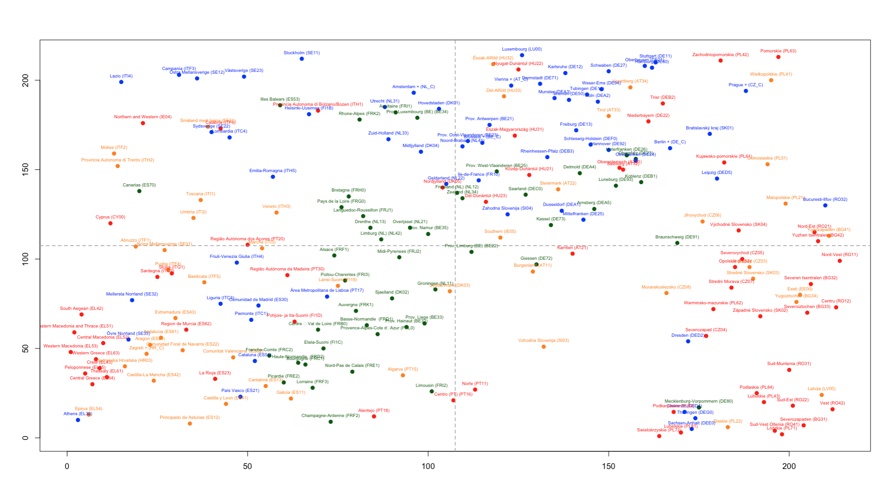
Complexity Loop, Structural Traps and Employment Dynamics
Employment Growth (2011-2019)
Wage Growth (2011-2019)
Notes:
THIS IS A GENERALIZATION OF RIGBY; PINHEIRO; BALLAND 2019

Slide 18
Regions in complexity loops → employment growth + wage growth
51.7%
25%
Employment Growth (2011-2019)
6.7%
16.7%
Wage Growth (2011-2019)
Notes:
THIS IS A GENERALIZATION OF RIGBY; PINHEIRO; BALLAND 2019

Slide 19
Regions in structural traps → employment decline
23.3%
10%
Employment Growth (2011-2019)
38.3%
28.3%
Wage Growth (2011-2019)
Notes:
This is driven by a cluster of Eastern EU regions

Slide 20
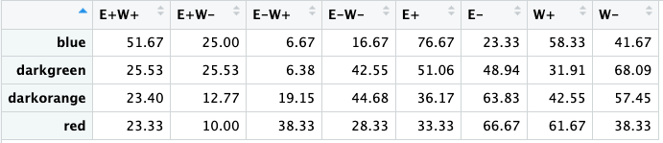
Employment Dynamics Summary Per Group – Industries

Slide 21
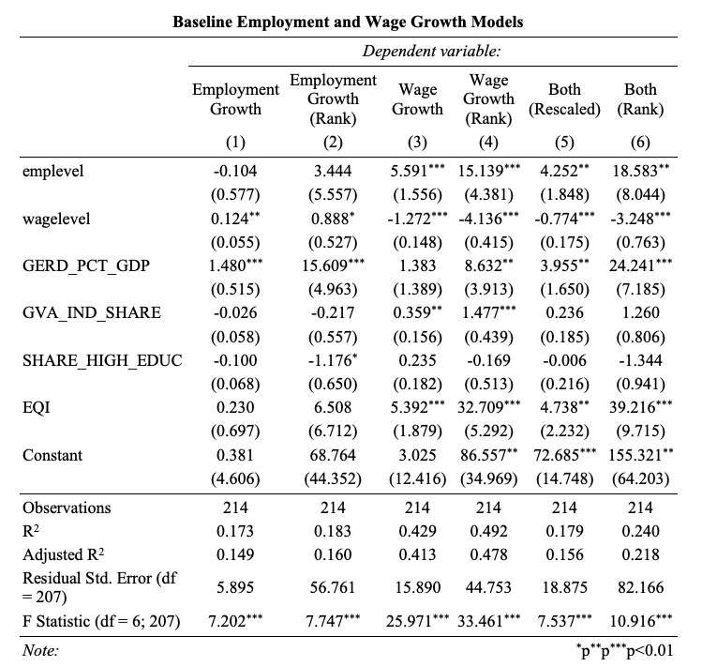

Slide 22
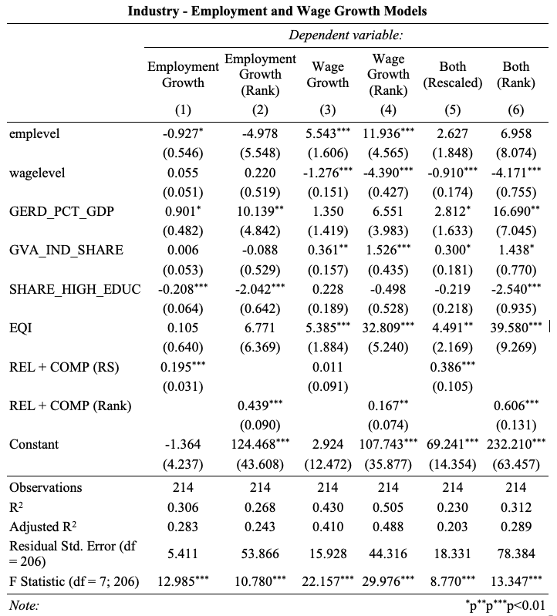

Slide 23
MEASURING STRUCTURAL TRAPS WITH TECHNOLOGY DATA (REGPAT)

Slide 24
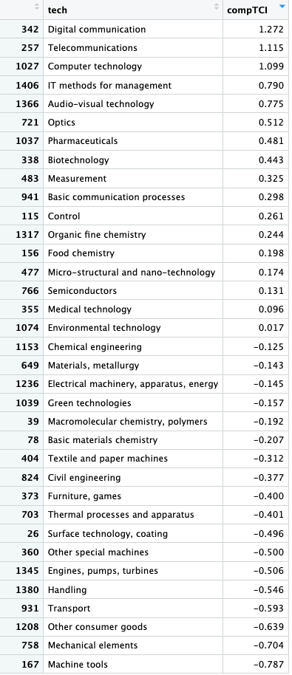
Tech Complexity Rankings (2011)
DATA:
- REGPAT, August 2023 version. Source of data: Organisation for Economic Co-operation and Development (OECD).
METHODOLIGICAL NOTE:
- Complexity scores are computed following the eigenvector reformulation. See Hidalgo & Hausman (2009) and for a more recent discussion of economic complexity indicators Balland et al. (2022).

Slide 25
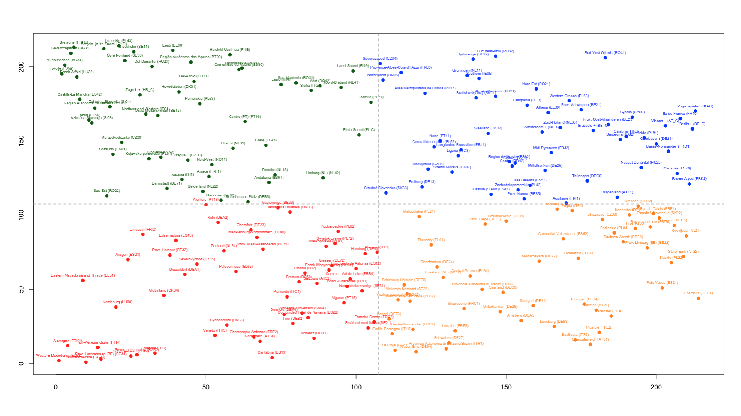
Complexity Loops & Structural Traps – Technologies (rank)
Average Complexity
Average Relatedness Density
Notes:
THIS IS A GENERALIZATION OF RIGBY; PINHEIRO; BALLAND 2019

Slide 26
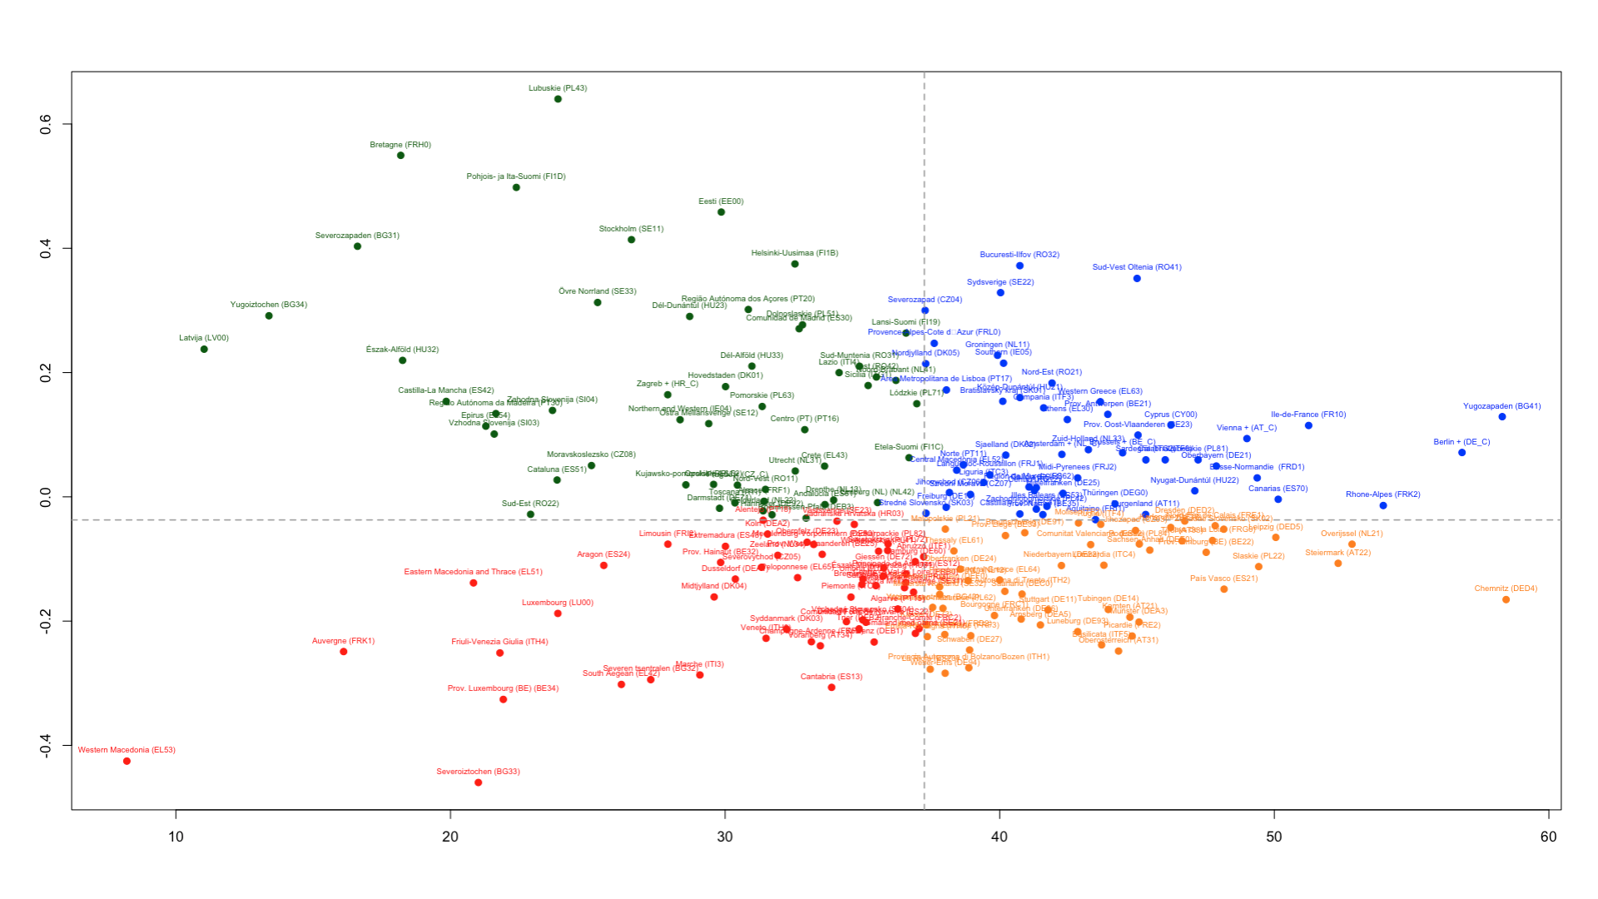
Complexity Loops & Structural Traps – Technologies (values)
Average Complexity
Average Relatedness Density
Notes:
THIS IS A GENERALIZATION OF RIGBY; PINHEIRO; BALLAND 2019

Slide 27
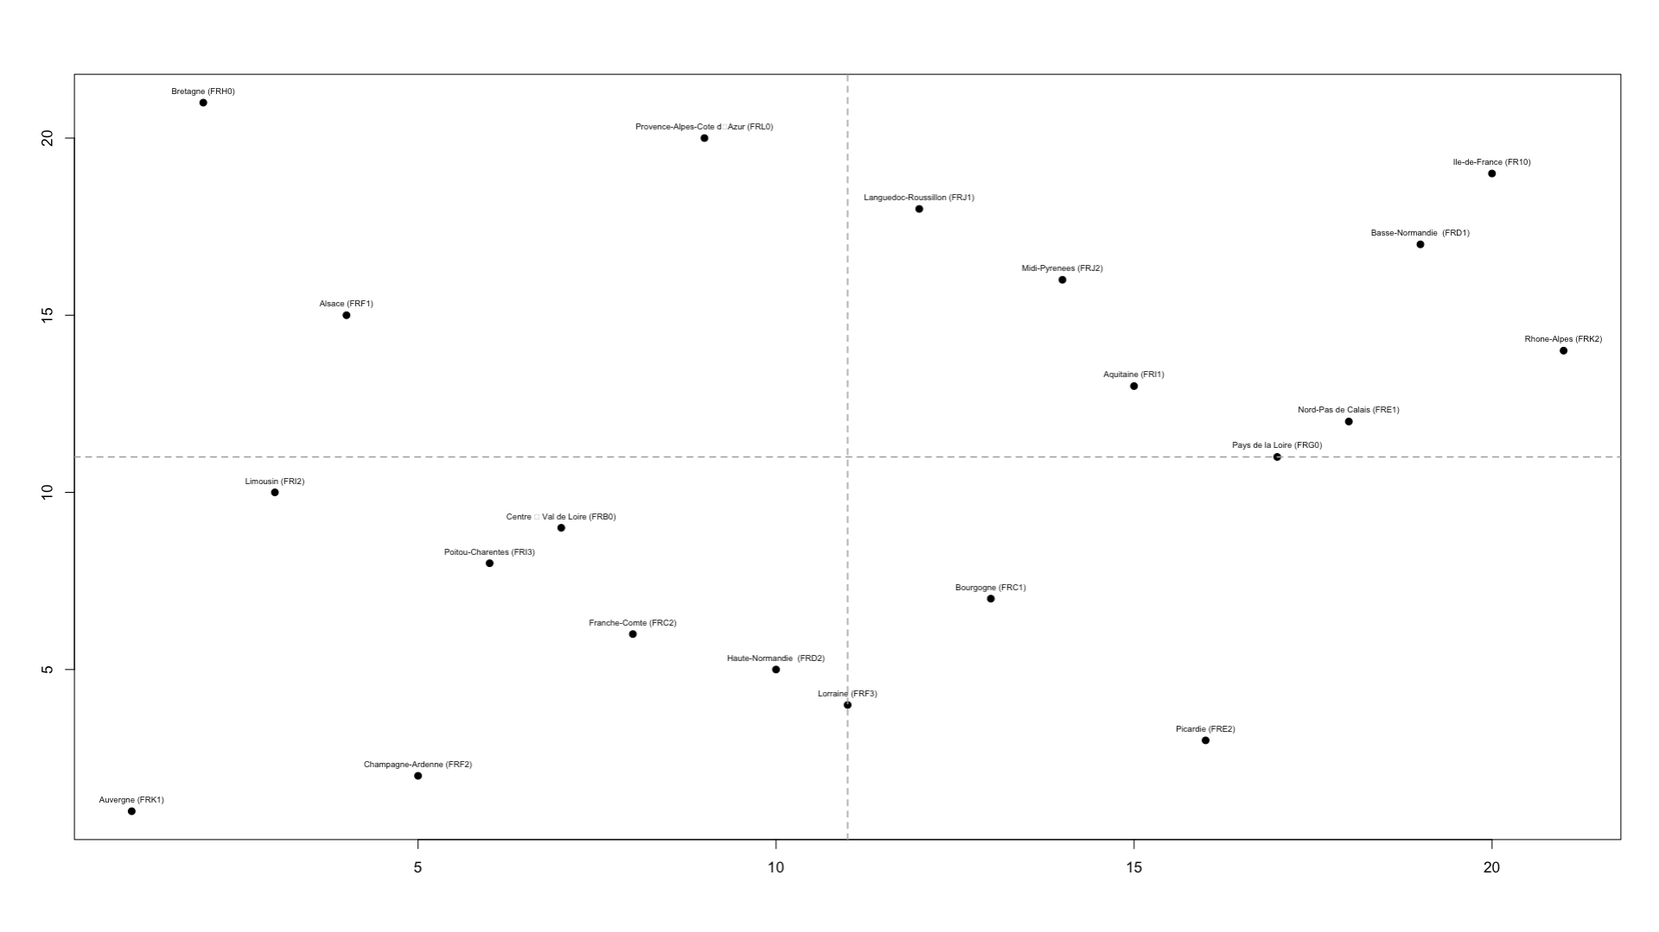
Complexity Loops & Structural Traps for France – Techs (rank)
Average Complexity
Average Relatedness Density
Notes:
THIS IS A GENERALIZATION OF RIGBY; PINHEIRO; BALLAND 2019

Slide 28
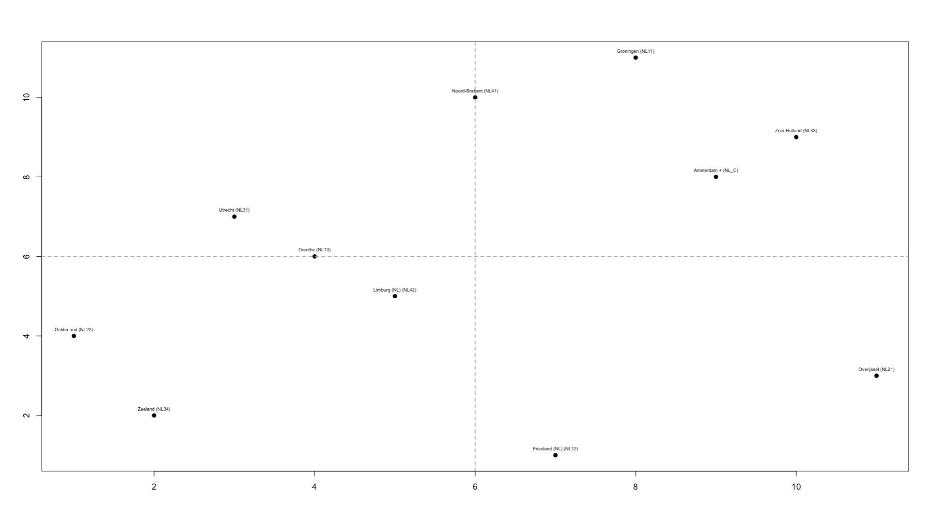
Complexity Loops & Structural Traps for the NL – Techs (rank)
Average Complexity
Average Relatedness Density
Notes:
THIS IS A GENERALIZATION OF RIGBY; PINHEIRO; BALLAND 2019

Slide 29
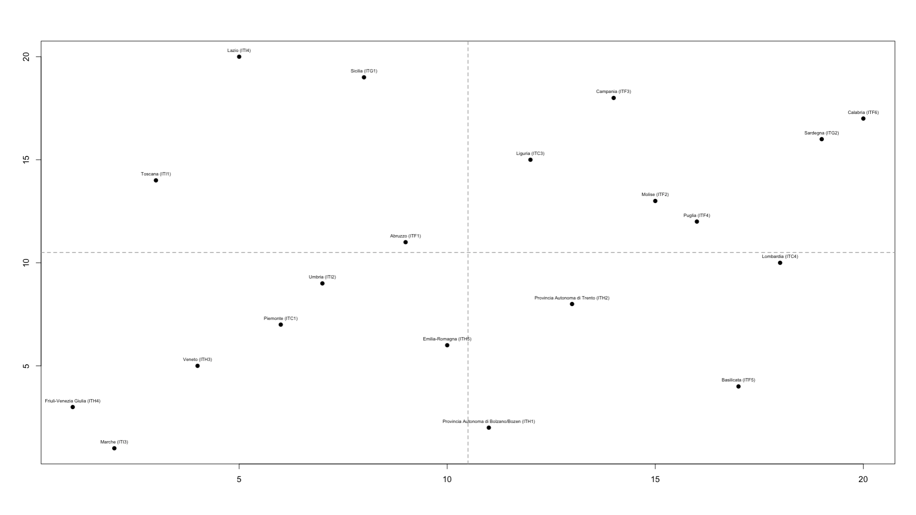
Complexity Loops & Structural Traps for Italy – Techs(rank)
Average Complexity
Average Relatedness Density
Notes:
THIS IS A GENERALIZATION OF RIGBY; PINHEIRO; BALLAND 2019

Slide 30
CAN (TECHNOLOGY) STRUCTURAL TRAPS EXPLAIN REGIONAL DEVELOPMENT?

Slide 31
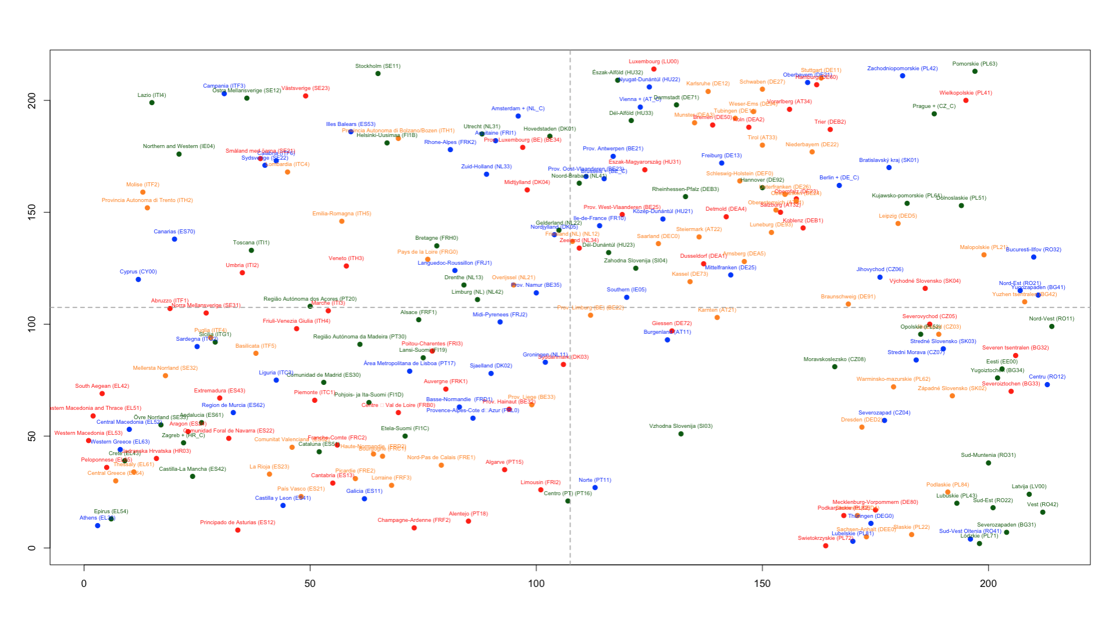
Complexity Loop, Structural Traps and Employment Dynamics
Employment Growth (2011-2019)
Wage Growth (2011-2019)
Notes:
THIS IS A GENERALIZATION OF RIGBY; PINHEIRO; BALLAND 2019

Slide 32
Regions in complexity loops → employment + wage growth
33.3%
24.7%
Employment Growth (2011-2019)
16.7%
25.9%
Wage Growth (2011-2019)
Notes:
THIS IS A GENERALIZATION OF RIGBY; PINHEIRO; BALLAND 2019

Slide 33
Regions in structural traps → employment decline
29.6%
11.1%
Employment Growth (2011-2019)
12.9%
46.3%
Wage Growth (2011-2019)
Notes:
THIS IS A GENERALIZATION OF RIGBY; PINHEIRO; BALLAND 2019

Slide 34
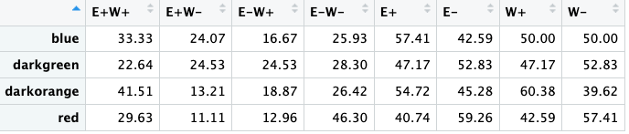
Employment Dynamics Summary Per Group – Technologies

Slide 35
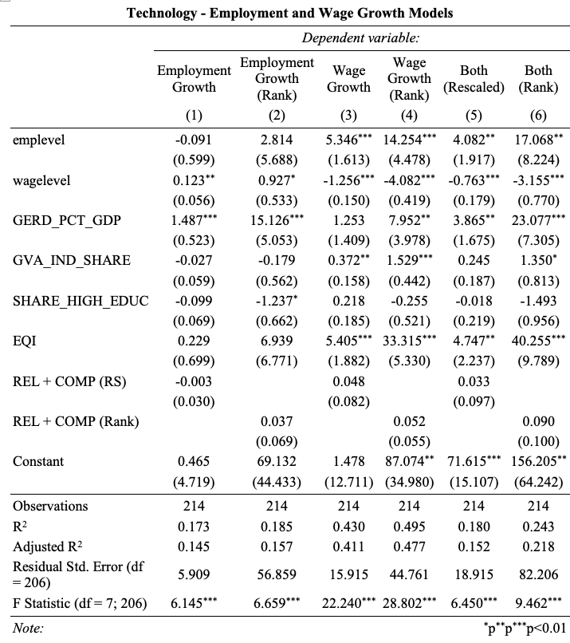

Slide 36
COMBINING INDUSTRY AND TECHNOLOGY DATA

Slide 37
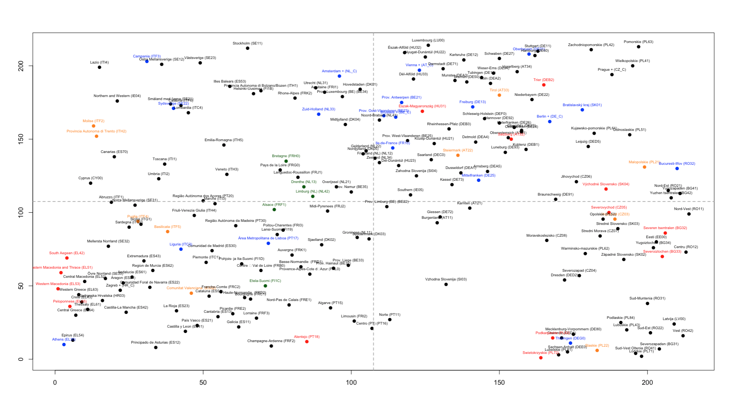
Combining industry and technology structures
57.9%
21%
Employment Growth (2011-2019)
5.2%
15.7%
Wage Growth (2011-2019)
Notes:
THIS IS A GENERALIZATION OF RIGBY; PINHEIRO; BALLAND 2019

Slide 38
Combining industry and technology structures
28.5%
0%
Employment Growth (2011-2019)
35.7%
35.7%
Wage Growth (2011-2019)
Notes:
THIS IS A GENERALIZATION OF RIGBY; PINHEIRO; BALLAND 2019

Slide 39
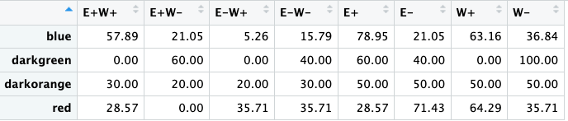
Structural Traps and Employment Dynamics – Industries & Techs

Slide 40
TRANSITIONING IN/OUT OF STRUCTURAL TRAPS

Slide 41
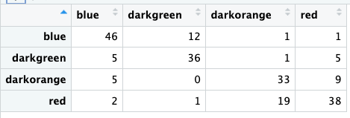
Structural traps transition matrix for industries

Slide 42
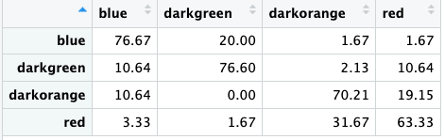
Structural traps transition matrix for industries (%)

Slide 43
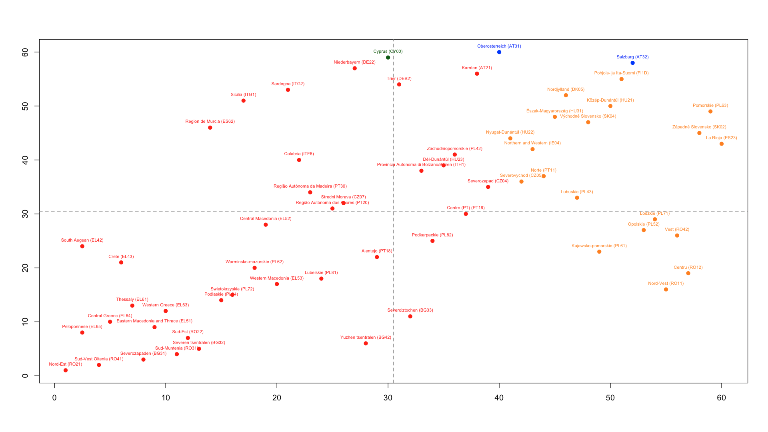
Structural Traps Dynamics 2011-19 for Industries (rank)
Average Complexity in 2019
Average Relatedness Density in 2019
Notes:
All regions here were in structural traps (they were red) in 2011

Slide 44
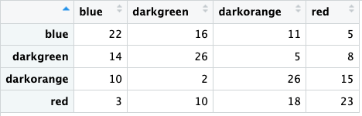
Structural traps transition matrix for technologies

Slide 45
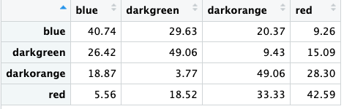
Structural traps transition matrix for technologies (%)

Slide 46
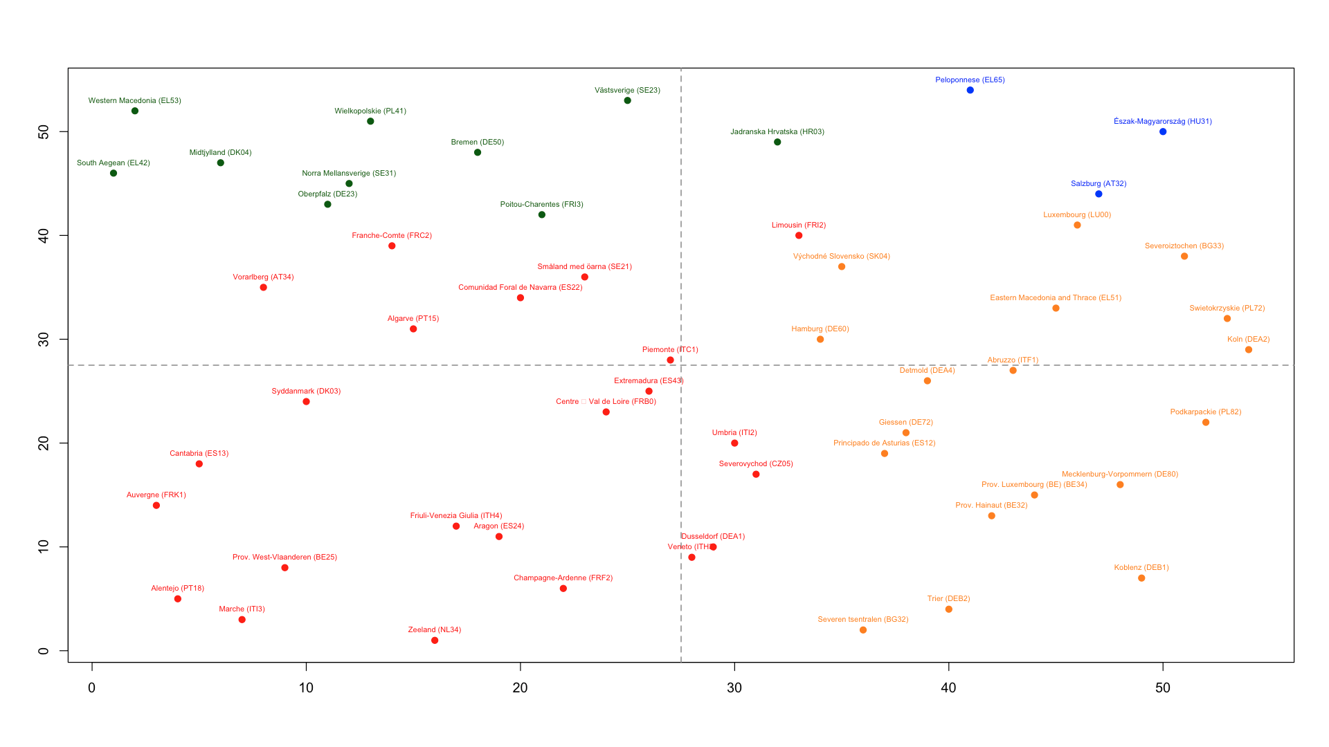
Structural Traps Dynamics 2011-19 for Technologies (rank)
Average Complexity in 2019
Average Relatedness Density in 2019
Notes:
All regions here were in structural traps (they were red) in 2011

Slide 47
ESCAPING STRUCTURAL TRAPS BY PRIORITIZING THE RIGHT TECH/IND SPECIALIZATIONS

Slide 48
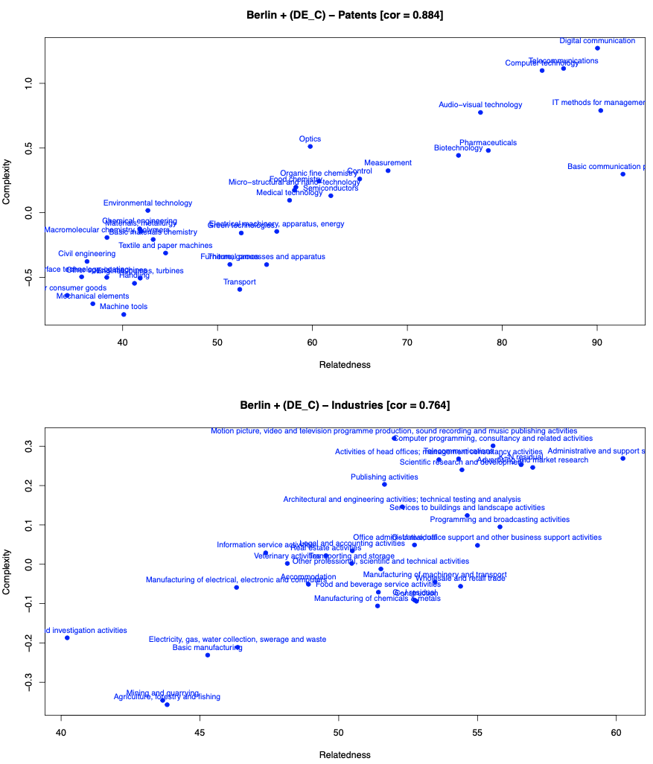

Slide 49
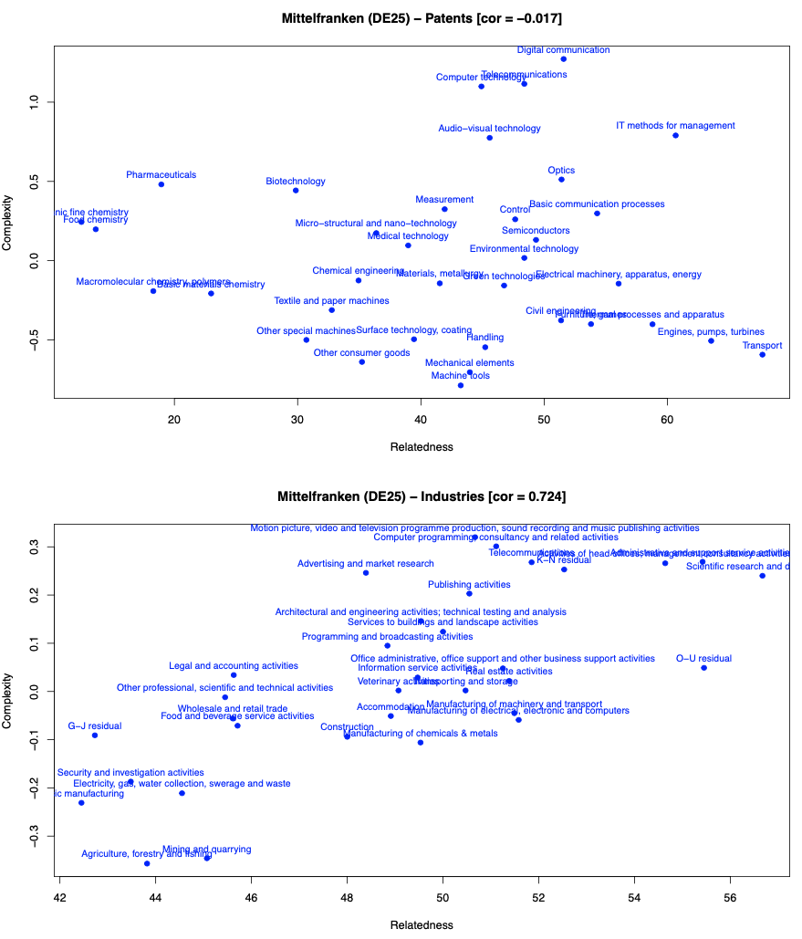

Slide 50
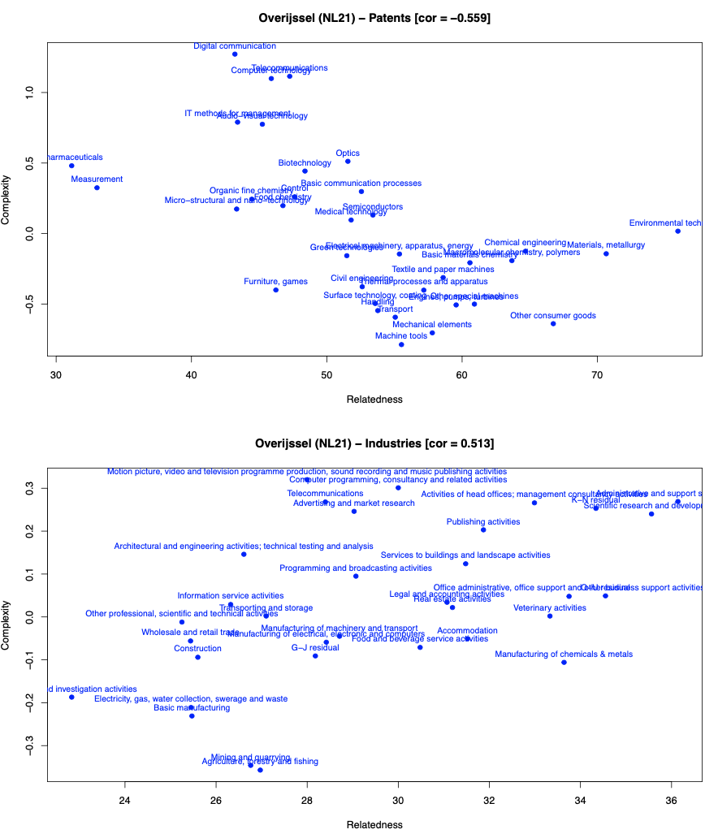

Slide 51
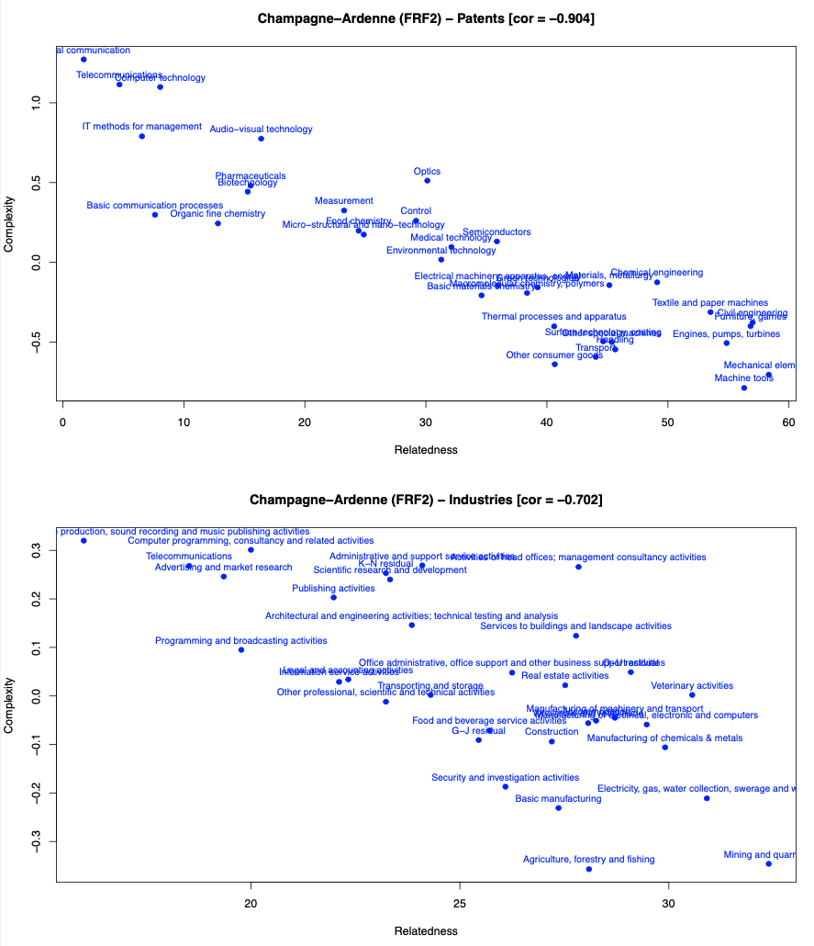

Slide 52
THANKS!

Slide 53
APPENDIX

Slide 54
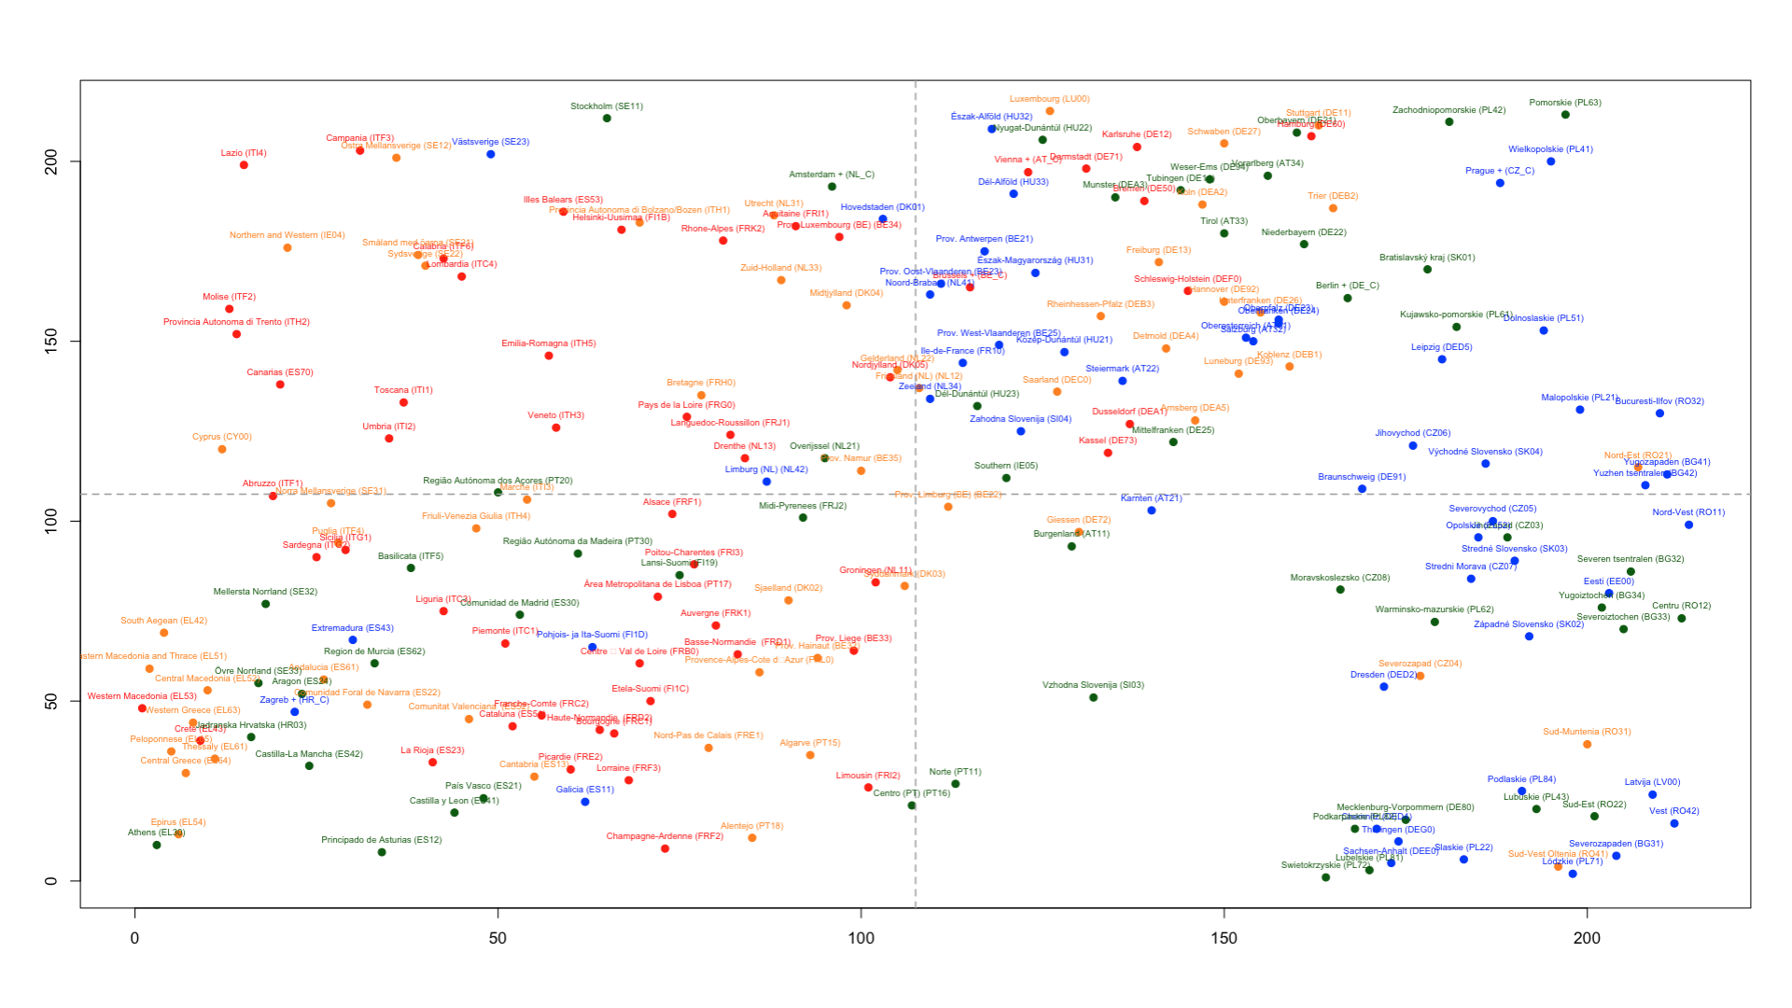
DEVELOPMENT TRAPS (DT1)
Employment Growth (2011-2019)
Wage Growth (2011-2019)
Notes:
THIS IS A GENERALIZATION OF RIGBY; PINHEIRO; BALLAND 2019

Slide 55
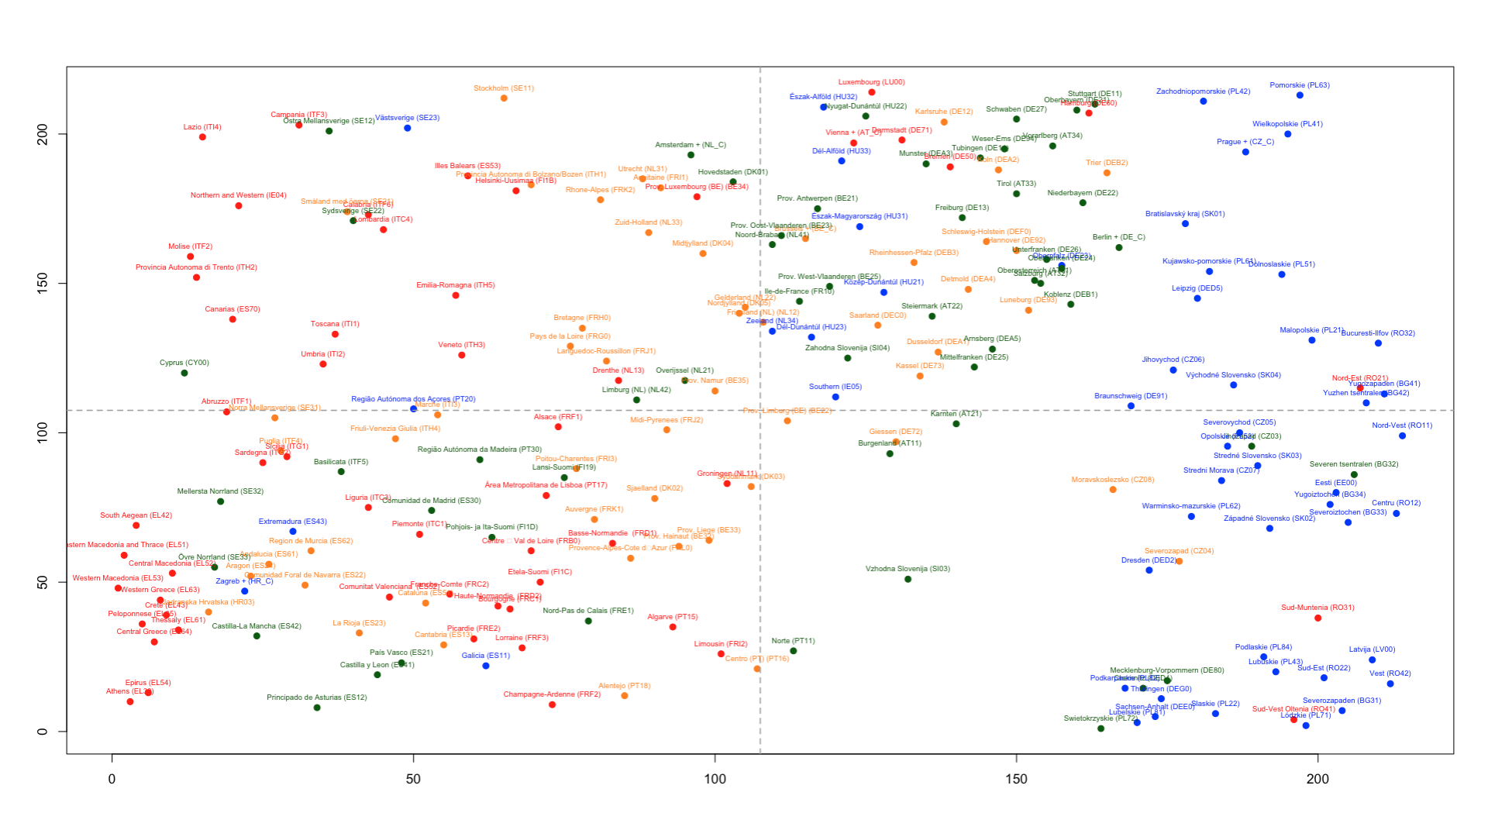
DEVELOPMENT TRAPS (DT2)
Employment Growth (2011-2019)
Wage Growth (2011-2019)
Notes:
THIS IS A GENERALIZATION OF RIGBY; PINHEIRO; BALLAND 2019

